Slide 1



SENTIMENT INTELLIGENCE:
Analyzing Textual Data
Team Members: Huda Saiyed Guide: Jay Rathod
Jaimini Chaudhari
Disclaimer: The content is curated for educational purposes only.

Slide 2
OUTLINE
Abstract
Problem Statement
Aims, Objective & Proposed System/Solution
System Design/Architecture
System Development Approach (Technology Used)
Algorithm & Deployment
Conclusion
Future Scope
References
Video of the Project
Notes:
These are the list of chapters that we are going to cover in these foundation codes. Those are chapter one what are AI and ML? chapter 2 applied Python programming in AI, and chapter 3 is exploratory data analysis for ML.

Slide 3
Abstract
This project utilizes natural language processing techniques to develop a sentiment analysis model, enabling the classification of text data as positive, negative, or neutral. By analyzing linguistic features and patterns, the model determines the emotional tone and opinion orientation of text inputs, providing valuable insights for various applications, such as customer feedback analysis, political opinion polling, and social media monitoring. The goal is to improve the accuracy and efficiency of sentiment analysis, enabling businesses and organizations to make informed decisions based on public opinions and sentiment trends.

Slide 4
Problem Statement
In today's digital era, businesses generate and receive an overwhelming amount of textual data from various sources, such as social media, customer reviews, and online feedback. This data holds valuable insights into customer sentiments and emotions, which are critical for making informed business decisions, improving customer satisfaction, and tailoring marketing strategies. However, analyzing and interpreting this data is challenging due to its variety, volume, and complexity. The primary challenges include preprocessing diverse textual data, accurately categorizing and detecting a wide range of emotions, identifying sentiments (positive, negative, neutral) amidst noisy data, and presenting these insights in an easily interpretable and visually appealing format. Our project, "Sentiment Intelligence: Analyzing Textual Data," aims to address these challenges by developing a robust system capable of analyzing emotions and sentiments from textual data.

Slide 5
Aim and Objective
Aim
The aim of this project, "Sentiment Intelligence: Analyzing Textual Data," is to develop an advanced system that utilizes natural language processing (NLP) techniques to accurately analyze and interpret emotions and sentiments from diverse textual data sources. This system is designed to provide businesses with deep insights into customer feedback and opinions, thereby enhancing their ability to make data-driven decisions, improve customer satisfaction, and optimize their marketing and service strategies. By integrating robust emotion and sentiment analysis capabilities with a user-friendly web interface, the project seeks to offer an accessible and practical tool for real-world applications.
Objective
- Develop a system for emotion analysis and visualization from text files.
- Build a sentiment analysis model using SVC and Random Forest algorithms.
- Apply NLP techniques for text preprocessing.
- Create a user-friendly web interface for input and visualization.
- Provide dynamic and interactive visualizations of analyzed data.
- Equip businesses with actionable insights from textual data.
- Validate and evaluate the accuracy of the analysis models.

Slide 6
Proposed Solution
Part 1: Emotion Detection Module
The proposed solution for the first part involves developing an emotion analysis system that processes text input by removing punctuation, stop words, and tokenizing the text. Using a predefined dictionary, the system categorizes named emotions into base emotions, counts their occurrences, and creates visualizations to represent the overall emotional content of the text. This approach allows users to input any speech or text and obtain a detailed visualization of the emotions expressed, providing insights into the emotional tone of the content.
Part 2: Sentiment Analysis Model
The second part focuses on building a sentiment analysis model that processes customer reviews labeled with sentiment categories ("positive," "negative," "neutral"). The data is cleaned and preprocessed using NLP techniques, and machine learning algorithms—Support Vector Classifier (SVC) and Random Forest—are employed for training. The model then predicts the sentiment of new reviews input by users. A user-friendly web interface supports this functionality, allowing users to enter reviews and receive sentiment predictions, thereby providing actionable insights into customer feedback and enhancing business decision-making.

Slide 7
System Architecture
Data Input Layer
Users interact with the system via the Textual Data Page and Review Data Page on the web application, where they input text for emotion analysis or customer reviews for sentiment analysis.
Preprocessing Layer
Text data undergoes preprocessing to remove punctuation, stop words, and tokenize the text. For sentiment analysis, similar NLP techniques are applied to prepare the review data.
Analysis Layer
The Emotion Analysis Module categorizes emotions using a predefined dictionary, counts occurrences, and creates visualizations. The Sentiment Analysis Model utilizes machine learning algorithms (SVC and Random Forest) to train on review data and predict sentiment for new inputs.

Slide 8
System Architecture
Visualization Layer
Results are presented through dynamic visualizations, including bar graphs for emotion counts and sentiment predictions, helping users easily interpret the data.
User Interface Layer
The web application consists of a Home Page with project details, a Textual Data Page for analyzing text and visualizing emotions, and a Review Data Page for sentiment prediction.
Summary
The system architecture integrates data input, preprocessing, analysis, visualization, and user interaction components, providing a comprehensive solution for analyzing and visualizing textual data.

Slide 9
System Deployment Approach
Programming Languages:
Python for machine learning, data processing, and web application development.
Libraries & Frameworks:
Data Preprocessing: Pandas for data manipulation and NLTK for tokenization, stopword removal, stemming, and lemmatization.
Feature Extraction: TF-IDF Vectorizer for converting text into numerical features.
Machine Learning: Scikit-Learn for implementing SVC, RandomForestClassifier, and for performance evaluation.
Visualization: Matplotlib and Seaborn for static and advanced plots, Plotly Express for interactive visualizations.
UI:
Streamlit for developing the interactive web application with no separate backend service.

Slide 10
System Deployment Approach
1. Preparation
The first step in deploying the "Sentiment Intelligence: Analyzing Textual Data" project involves preparing the application for deployment. This includes reviewing and finalizing all Streamlit and Python (.py) files to ensure they are complete and functional. Comprehensive documentation is prepared, outlining the setup instructions, configuration details, and user guide to facilitate the deployment process and assist users in navigating the application.
2. Testing
Before deployment, the application undergoes thorough local testing to verify its functionality and performance. This involves running the Streamlit application in a local environment to ensure that all components—such as emotion analysis and sentiment analysis—work correctly. Setting up a testing environment that mimics the production setup can help identify and resolve potential issues before the application goes live.
3. Deployment Preparation
For deployment, the application code, including all Python scripts, models, and dependencies, is packaged into a deployable unit. The requirements file lists all necessary libraries and frameworks. Since the application is built using Streamlit for the web interface, no separate backend service is required. The deployment platform is chosen based on compatibility with Python and Streamlit, such as Streamlit Sharing or a cloud service like AWS, Azure, or Google Cloud.

Slide 11
System Deployment Approach
4. Deployment
The deployment process involves uploading the packaged application to the selected hosting platform. The environment is configured to install dependencies listed in the requirements file. As the application uses Streamlit, there is no need for additional API development frameworks like Flask or Django. The application is launched on the platform, ensuring that it is accessible and functioning properly for users.
5. Post-Deployment
Following deployment, monitoring tools are implemented to track the application's performance and health. This includes checking logs and performance metrics to address any issues promptly. Regular maintenance is performed to apply updates, fix bugs, and enhance the application based on user feedback and performance data.
6. User Training and Support
User training materials or sessions are provided to help users navigate the Streamlit application and understand the results from emotion and sentiment analysis. Support channels are established to assist users with any issues they encounter, ensuring a positive experience and effective use of the application.

Slide 12
Algorithm & Deployment
Algorithms:
Support Vector Machines (SVM): Used for margin-based classification to predict the sentiment of text reviews (positive, negative, neutral).
Random Forest Classifier: Utilized for robust sentiment classification by combining multiple decision trees to improve prediction accuracy.
Sentiment Intensity Analysis: Applied to analyze the intensity and polarity of emotions in text, effectively detecting sentiment nuances and emotions.
Deployment:
Integration: The Streamlit web application integrates sentiment and emotion analysis features, allowing users to interact with the model and view results within the app.
User Interface: The Streamlit application includes a user-friendly dashboard with interactive visualizations, such as dynamic bar graphs, for displaying sentiment and emotion analysis results.
API Development: No separate API is developed; real-time sentiment and emotion analysis are provided directly through the Streamlit application.

Slide 13
Algorithm for Sentiment Analysis System
Load the Emotion File: Load the file that categorizes words into groups of base emotions, forming the basis for emotion detection.
Read Input Text: Read text content from the file named read.txt to analyze its emotional content.
Remove Punctuation: Strip punctuation from the text to ensure clean data for further processing.
Tokenize the Text: Split the text into individual words using NLTK’s word_tokenize for detailed analysis.
Remove Stopwords: Filter out common stopwords using NLTK’s stopword list to focus on meaningful words.
Apply Stemming or Lemmatization: Convert words to their base forms using PorterStemmer or WordNetLemmatizer to standardize the text.
Map Words to Emotions: Match the processed words with the emotion dictionary to identify and count occurrences of each base emotion.
Create Visualizations: Use Matplotlib and Seaborn to create visualizations, such as bar graphs, displaying the detected emotions.
Interactive Visualizations: Use Plotly Express for dynamic, interactive visualizations of the emotion data, enhancing user interaction.

Slide 14
Algorithm for Sentiment Analysis Model
Load the CSV File: Read the CSV file containing reviews and their corresponding sentiments to prepare for analysis.
Remove Punctuation from Reviews: Clean the review texts by removing punctuation, ensuring the data is ready for processing.
Filter Out Stopwords: Use NLTK’s stopword list to remove common stopwords from the reviews, focusing on significant words.
Apply Stemming or Lemmatization: Standardize the text by converting words to their base forms using PorterStemmer or WordNetLemmatizer.
Extract Features: Convert the cleaned text into numerical features using TfidfVectorizer for machine learning algorithms.
Split the Dataset: Divide the dataset into training and testing sets using train_test_split for model training and evaluation.
Train the SVC Model: Train a Support Vector Classifier (SVC) on the training data to classify sentiments.
Train the Random Forest Classifier: Train a Random Forest Classifier on the training data to enhance sentiment prediction accuracy.
Predict Sentiments: Use the trained models to predict sentiments on the test data, evaluating their performance.
Evaluate Model Performance: Calculate performance metrics such as accuracy and F1 score to assess model effectiveness.
Predict New Reviews: Take new review input, preprocess it, extract features, and predict its sentiment using the trained models.

Slide 15
Deployment
Development Environment Setup: Configure the development environment by installing Python and essential libraries like Streamlit, NLTK, Pandas, Scikit-Learn, Matplotlib, Seaborn, and Plotly Express. Develop the web application locally using Streamlit, integrating all functionalities for text processing, emotion detection, sentiment analysis, and visualizations.
Local Testing: Conduct rigorous local testing to ensure all features work correctly and interact seamlessly. Debug any issues to ensure the application functions as intended before moving to deployment.
Application Deployment: Deploy the Streamlit application on a cloud platform such as Streamlit Sharing or Heroku. Configure the deployment environment to mirror the local setup, including all necessary files and dependencies, to make the application accessible online.
Deployment Configuration: Adjust environment settings and configure dependencies to match the application's needs. Verify platform compatibility to ensure stable and effective performance.
User Access: Provide users with a URL to access the deployed application. Ensure the interface is user-friendly and intuitive, allowing users to interact with the application and view results through interactive visualizations.
Monitoring and Maintenance: Regularly monitor the application’s performance, address any issues, and update as needed. Maintain security and efficiency to ensure the application remains reliable and effective for users.

Slide 16
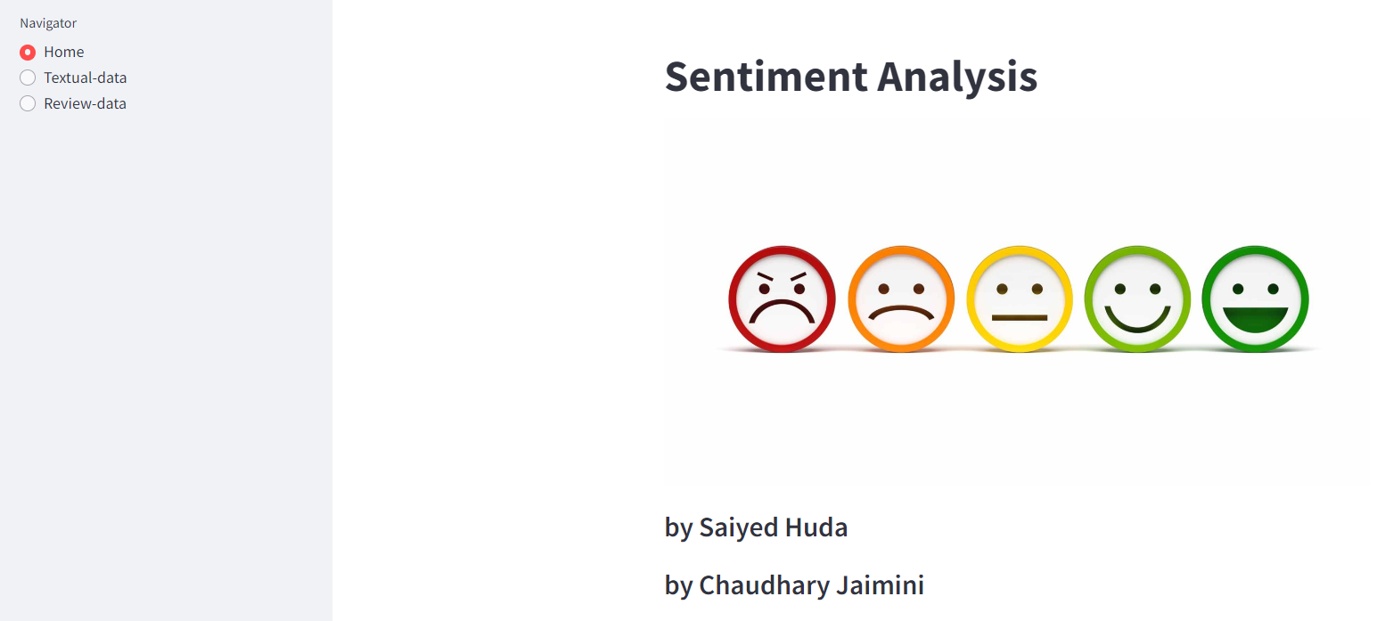
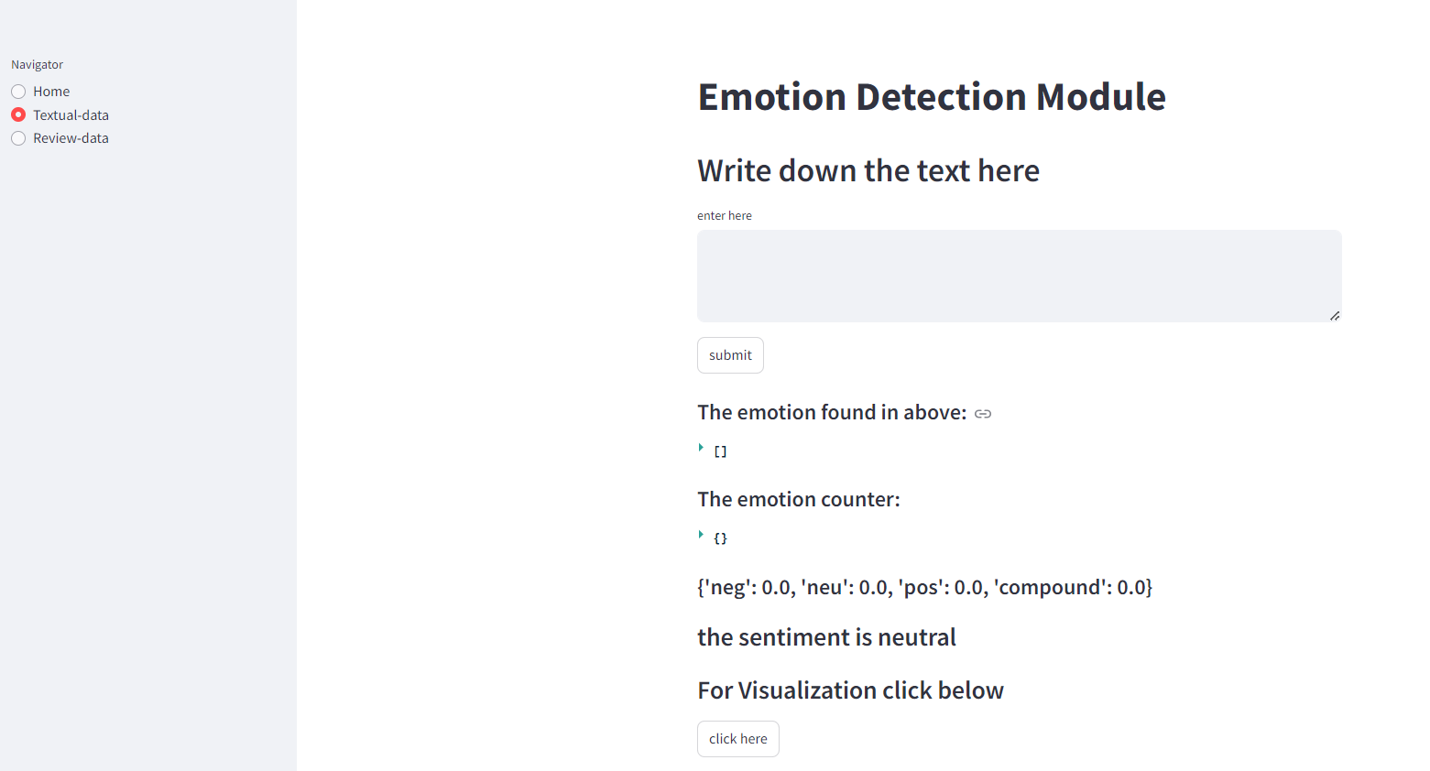
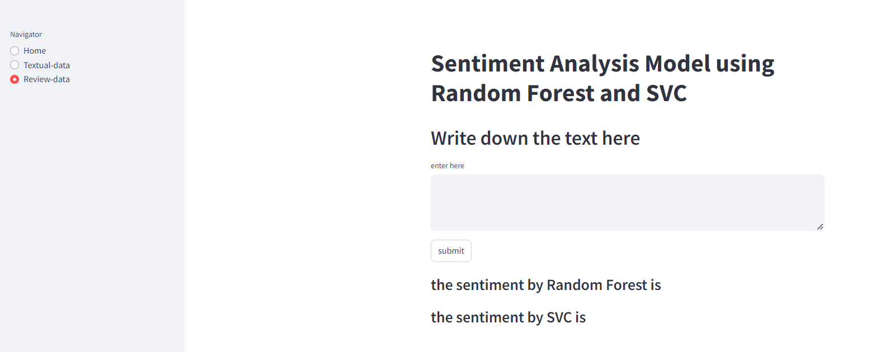
Deployment on Web Browser:

Slide 17
Conclusion
The "Sentiment Intelligence: Analyzing Textual Data" project successfully demonstrates the application of machine learning and natural language processing techniques to analyze and visualize textual data. By leveraging Support Vector Machines (SVM) and Random Forest Classifier, the project provides robust sentiment classification, while Sentiment Analysis enhances the analysis of emotional intensity and polarity.
The integration of these techniques into a Streamlit web application allows for real-time sentiment and emotion analysis, providing users with interactive and intuitive visualizations. This approach not only enhances the understanding of textual data but also offers practical insights for various applications, such as customer feedback analysis and content evaluation.
Overall, the project highlights the effectiveness of combining traditional machine learning algorithms with advanced sentiment analysis tools, resulting in a comprehensive and user-friendly solution for analyzing and visualizing textual data.

Slide 18
Future Scope
Integration with Additional Data Sources: Expanding the project to analyze data from sources like social media and news articles would provide a more comprehensive view of sentiment and emotion, broadening its applicability.
Advanced Deep Learning Models: Incorporating models such as BERT or LSTM could improve the accuracy of sentiment analysis by capturing more nuanced emotions and contexts.
Multilingual Support: Adding support for multiple languages would extend the project's reach, enabling it to analyze sentiment across different linguistic and cultural contexts.
Real-Time Feedback and Adaptation: Implementing mechanisms for real-time feedback would allow the model to continuously improve based on user interactions and new data, enhancing its accuracy and relevance.
Enhanced Visualization and Reporting: Upgrading the user interface with advanced visualization tools and detailed reporting features would provide deeper insights and facilitate more comprehensive trend analysis.

Slide 19
Links:
GitHub Link: https://github.com/HudaSaiyed/Sentiment-Intelligence

Slide 20
Reference
http://www.oreilly.com/data/free/the-new-artificial-intelligence-market.csp
https://www.researchgate.net/publication/323777436_Document_Level_Sentiment_Analysis_A_survey
https://realpython.com/python-nltk-sentiment-analysis/
Notes:
Reference
These are the references for this session.
20

Slide 21
Thank you!
Notes:
thank you very much for joining this PPT, keep learning.
21

